Slide 1
Atomic Symbols

Slide 2
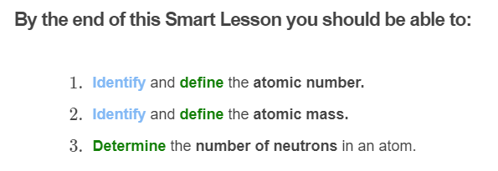
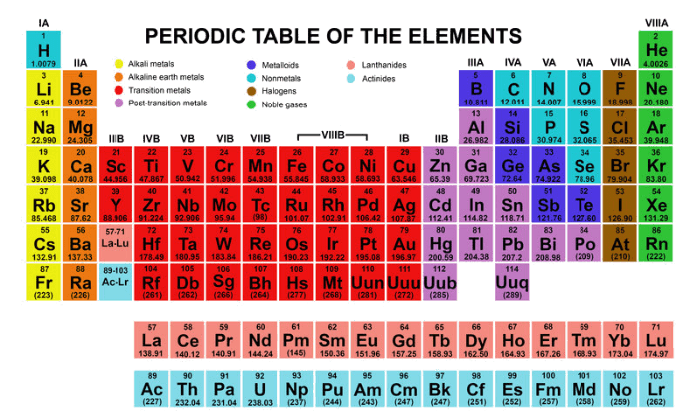

Slide 3
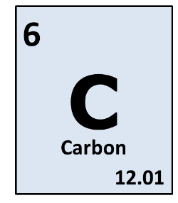
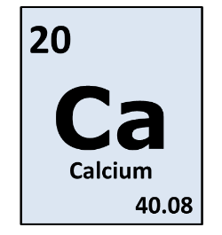
You may recall that each element has a unique chemical symbol that we can use to identify it.
Most letters come from the name of the element, for example C for carbon and O for oxygen. The first letter is always a capital.
If the first letter already belongs to another element, a second letter is added to the chemical symbol. For example, Ca is used for calcium because C is already used for carbon. The second letter is always lowercase.

Slide 4
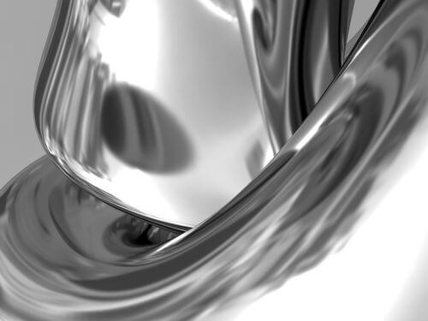
Some chemical symbols do not resemble the name we use for the element.
For example, we use Ag to represent silver.
This is because the Latin name for silver is argentum. Can you guess which country's name was derived from this word?

Slide 5

So how do we tell the difference between different types of atoms?
How do we know that a carbon atom is a carbon atom and not an oxygen atom?

Slide 6
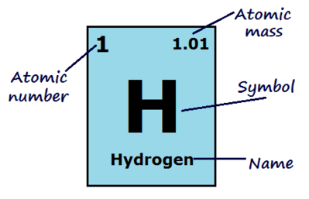
It all comes down to the number of protons in the nucleus.
A carbon atom has 6 protons in the nucleus and an oxygen atom has 8. The number of protons in the nucleus is called the atomic number. This is equal to the number of electrons in a neutral atom.
The atomic number of an element is always shown in its box on the periodic table.

Slide 7
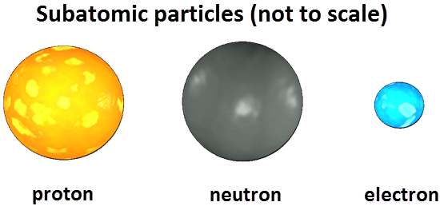
The mass number is the mass of one atom of an element.
It is the number of protons plus the number of neutrons in the nucleus of the atom.
Electrons are not considered when calculating the mass number because their mass is so small compared to protons and neutrons.

Slide 8

Because elements are only defined by the number of protons they have, they can have different numbers of neutrons.
Both neutrons and protons contribute to the mass of an atom, so different atoms of the same element can have different mass numbers.
Atomic mass is the average mass number of an element. Being a calculated average, the atomic mass is usually not a whole number. This is the value displayed on the periodic table alongside the atomic number.

Slide 9
To find the number of neutrons in an atom, subtract the atomic number from the mass number:
For example, the mass number (number of protons + neutrons) of one form of hydrogen could be 2, and the atomic number (number of protons) is 1. Therefore the number of neutrons in this hydrogen atom is 2−1=1.

Slide 10
